Slide 1
Portfolio Optimization Under Estimation Uncertainty
Bayesian and Bootstrap Analysis of Mean-Variance Portfolio Choice
Computational Statistics
Haneum Claude Lee
Johns Hopkins University

Slide 2
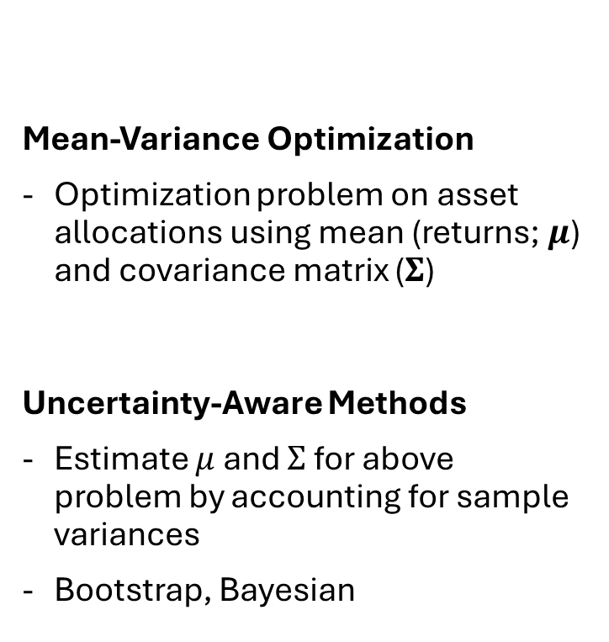
Portfolio Optimization as a Statistical Problem
Research Questions
How sensitive is mean-variance portfolio optimization to uncertainty in estimated returns and covariances?
➔ Application for Parameter estimation
= Statistical Problem
Do uncertainty-aware methods produce more stable portfolio allocations?
Mean-Variance Optimization
Optimization problem on asset allocations using mean (returns; $μ$) and covariance matrix ($Σ$)
Uncertainty-Aware Methods
Estimate $μ$ and $Σ$ for above problem by accounting for sample variances
Bootstrap, Bayesian

Slide 3
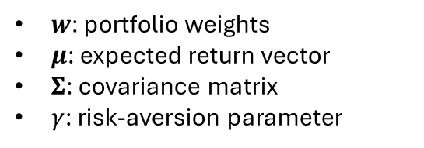
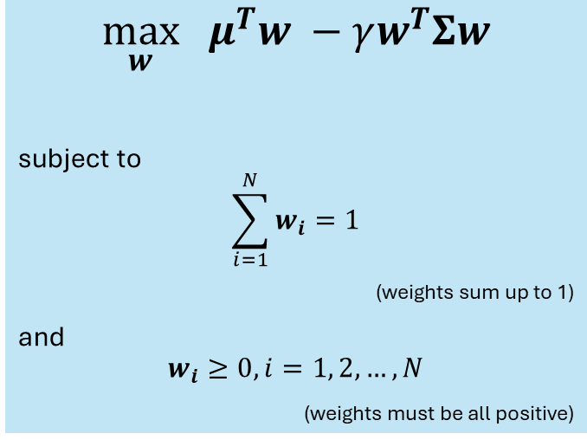
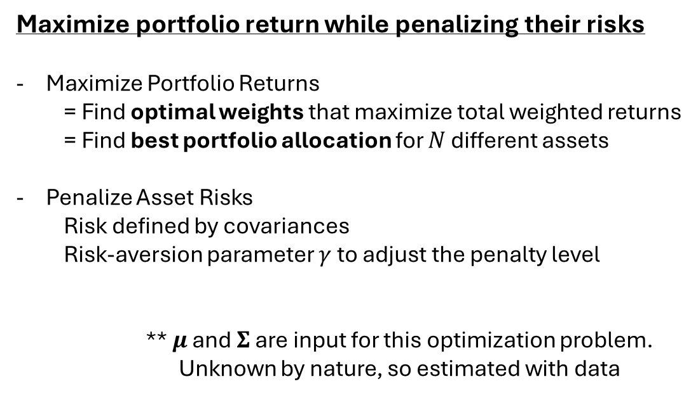
Mean-Variance Framework in Portfolio Allocations
Portfolio = Set of (financial) assets allocated with various weights
Portfolio Return = weighted sum of induvial asset returns $= w_{1}μ_{1}+…+w_{N}μ_{N}=μ^{T}w$
$$\max_{w} μ^{T}w −γw^{T}Σw$$
subject to
$$\sum_{i=1}^{N}{w_{i}}=1$$
(weights sum up to 1)
and
$$w_{i}≥0, i=1, 2, …, N$$
(weights must be all positive)
Maximize portfolio return while penalizing their risks
Maximize Portfolio Returns
= Find optimal weights that maximize total weighted returns
= Find best portfolio allocation for $N$ different assets
Penalize Asset Risks
Risk defined by covariances
Risk-aversion parameter $γ$ to adjust the penalty level
** $μ$ and $Σ$ are input for this optimization problem.
Unknown by nature, so estimated with data
$w$: portfolio weights
$μ$: expected return vector
$Σ$: covariance matrix
$γ$: risk-aversion parameter

Slide 4

Estimation of $μ$ and $Σ$
**Separate problem from optimization problem
Simple Plug-In Estimation:
Use means of sample data
Does not account for sample variance (uncertainty)
Uncertainty-Aware Estimation:
Use means AND variances of sample data with computational statistical techniques (Bootstrap and Bayesian/MCMC)
Additional layer to capture for sample uncertainty
This is separate from penalizing covariance in optimization problem

Slide 5
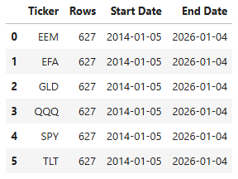
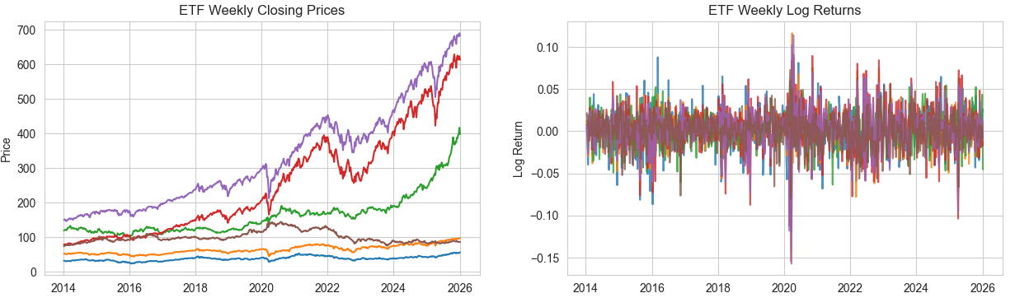
Portfolio Data & Prep
6 ETFs obtained from Stooq (https://stooq.com/)
Rationale: small & universal funds, easily exportable
Weekly for 10-year (2014-01-01 to 2023-12-31) as training set
+ 2 years (2024-01-01 to 2025-12-31) as holdout set
Rationale: consistent & clear-cut range for all 6 funds
End of week values for chosen range
Log-transform
Simpler statistical applications

Slide 6
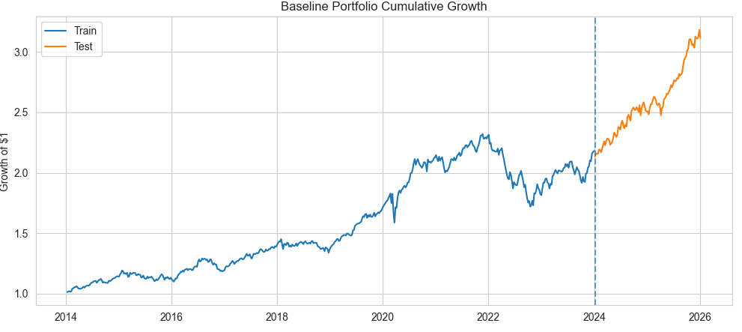
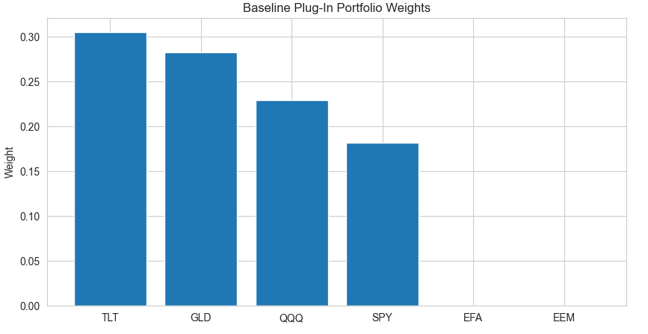
Simple Plug-In Estimation
Calculate sample mean and covariances & apply optimization**
Baseline solution to be compared with uncertainty-aware methods
Notice 0 weights for EFA and EEM, which just indicates that those funds do not perform well based on estimation
**solve optimization using cvxpy package in Python

Slide 7
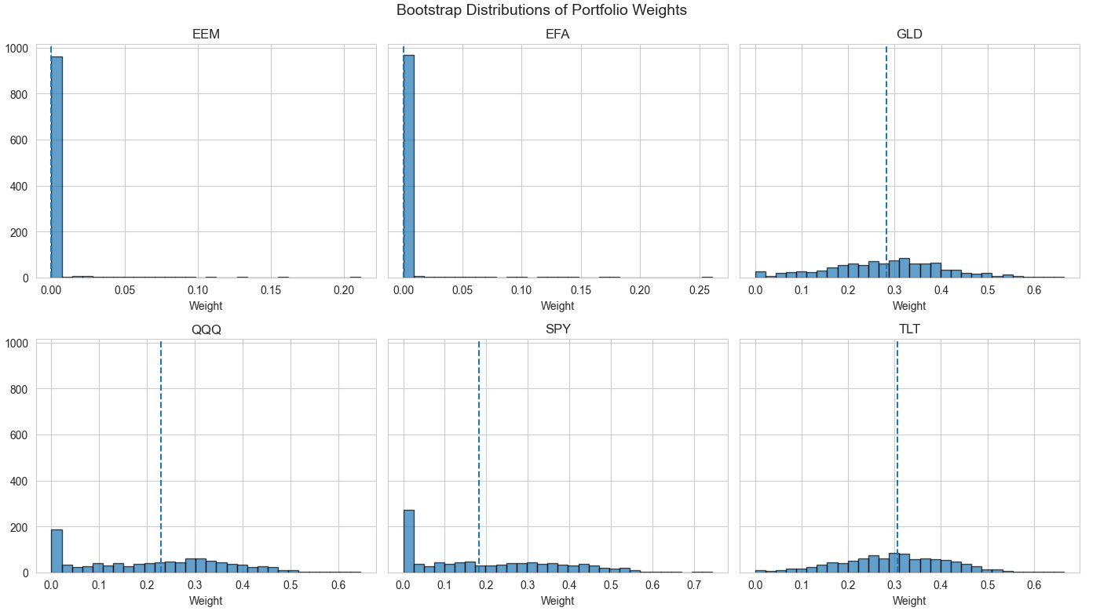
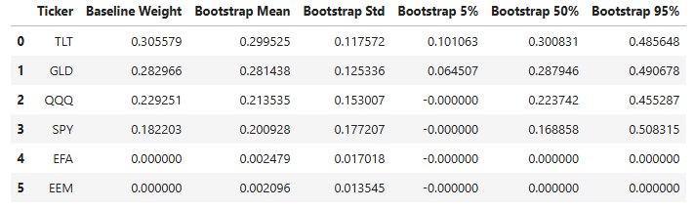
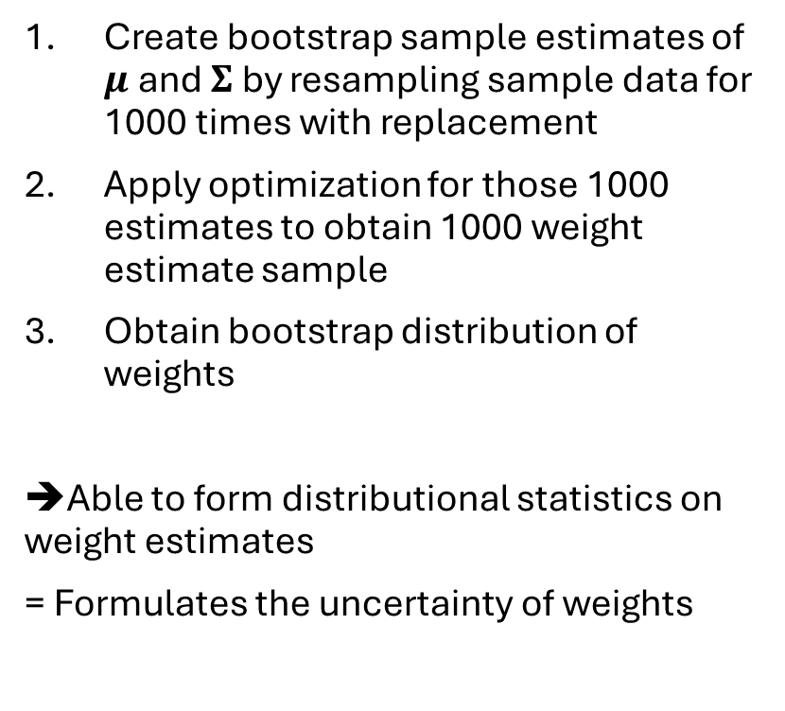
Uncertainty-Aware Estimation 1. Bootstrap
Create bootstrap sample estimates of $μ$ and $Σ$ by resampling sample data for 1000 times with replacement
Apply optimization for those 1000 estimates to obtain 1000 weight estimate sample
Obtain bootstrap distribution of weights
➔Able to form distributional statistics on weight estimates
= Formulates the uncertainty of weights

Slide 8
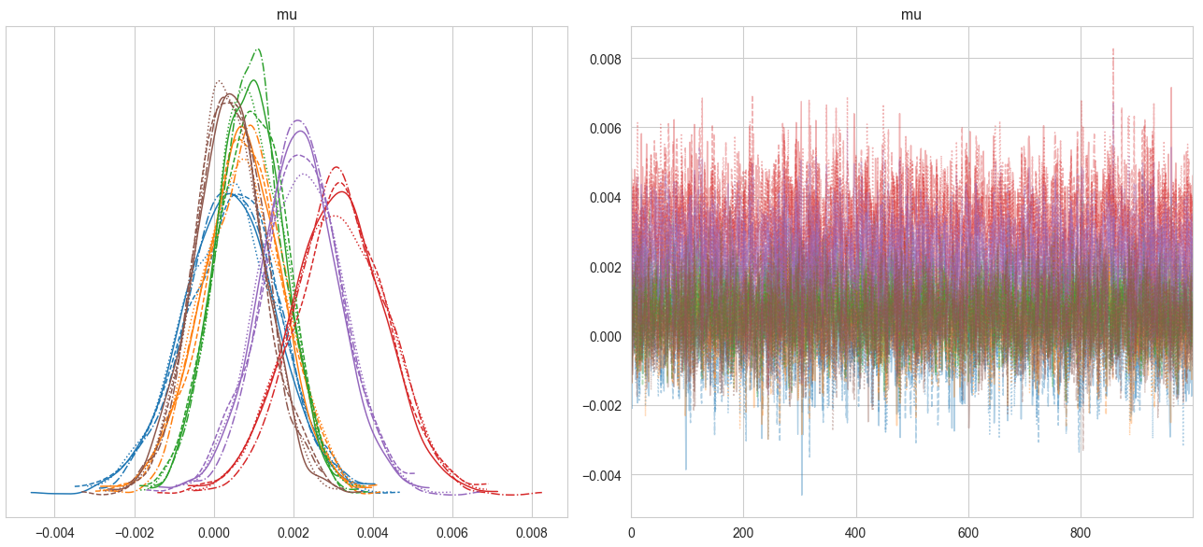
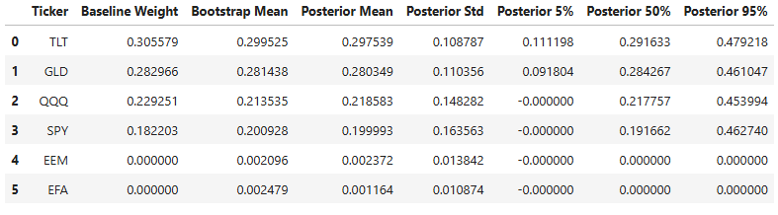
Uncertainty-Aware Estimation 2. Bayesian with Markov Chain Monte Carlo
Define Bayesian model for posterior with domain knowledge
Apply MCMC** for 1000 iterations (after 1000 tuning) to draw plausible posterior based on Bayesian setup
Obtain Bayesian distribution of weights
➔Same distributional benefits as bootstrap, but more tuning with domain knowledge using Bayesian model
Traces and density plots show decent convergence on all 6 weights, indicating successful MCMC.
**solve using pymc and arviz package in Python

Slide 9
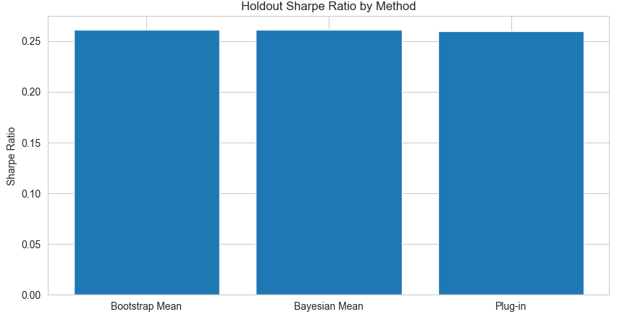
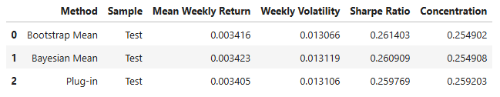
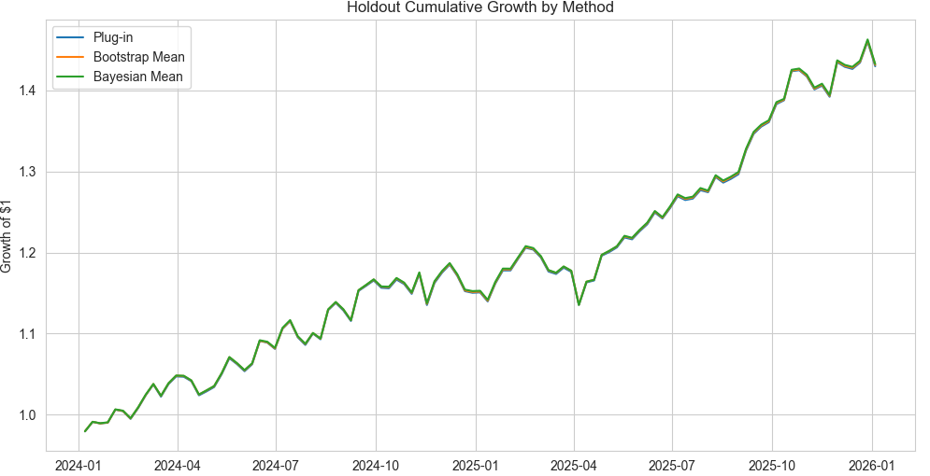
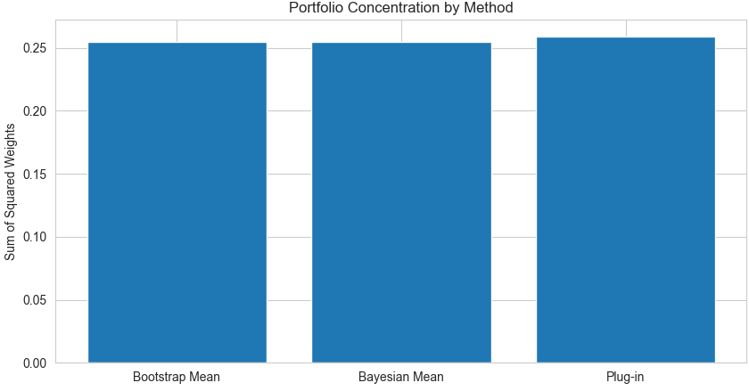
Results Comparison on Holdout Set
Sharpe Ratio = mean / volatility
All three methods seem to perform similar on holdout set.
However, uncertainty-aware method revealed instability measures of those estimates.
Concentration = SS of Weights (overall spread)

Slide 10
Conclusion
Portfolio optimization is a statistical problem
Limitations
Small asset selection
Limited trials on Bayesian model parameter
Soley focused on estimation uncertainty, not other market factors
Lesson
Uncertainty-awareness methods reveal estimation instability metrics that plug-in method cannot create

